Slide 1


DL TEAM BETA
Handwritten Character Recognition

Slide 2

Data Preprocessing
This document outlines the data preprocessing steps for a machine learning project. The goal is to prepare the data for training a model.

Slide 3

Imports
The first step is to import the necessary libraries. These libraries provide the tools for data manipulation, model building, and visualization.
TensorFlow
A powerful open-source library for machine learning.
Keras
A high-level API for building and training neural networks.
NumPy
A library for numerical computing in Python.
Matplotlib
A library for creating static, animated, and interactive visualizations in Python.

Slide 4
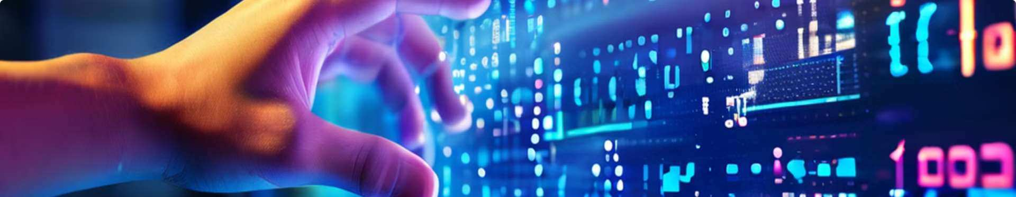
Data Collection
The MNIS T dataset is loaded using the keras.datasets library. This dataset contains handwritten digits from 0 to 9.
1
X_train
Training images.
2
y_train
Labels for training images.
3
X_test
Test images.
4
y_test
Labels for test images.

Slide 5
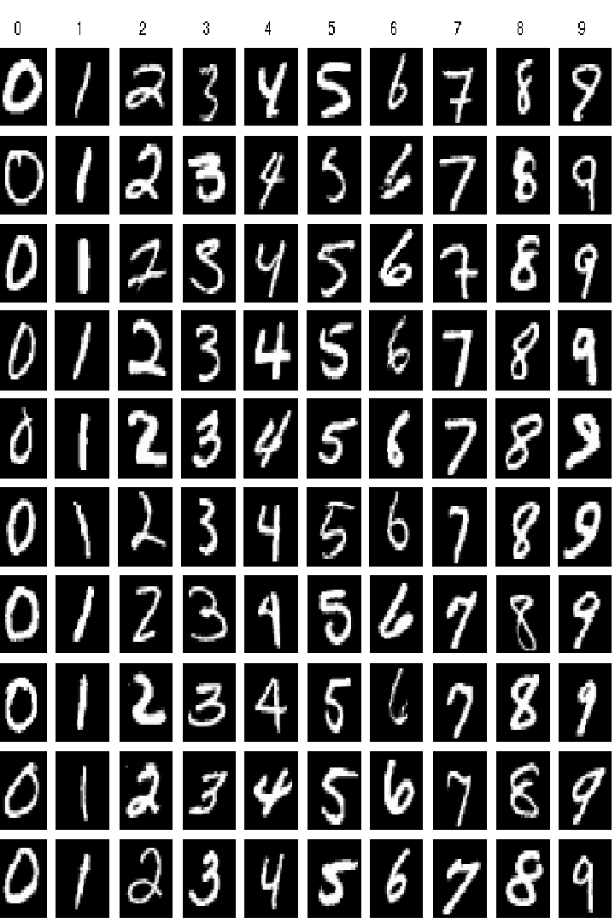
MNIS T Data Set
MNIST dataset serves as a significant database of handwritten digits, commonly utilized for training diverse image processing systems.
Comprises 60,000 training images to facilitate the development and enhancement of machine learning models.
MNIST dataset serves as a significant database of handwritten digits, commonly utilized for training diverse image processing systems.

Slide 6

Data Proces sing
The data is processed to improve its quality and prepare it for training.
1
Normalization
Pixel values are scaled to the range of 0 to 1.
2
Noise R eduction
Gaussian blur is applied to reduce noise in the images.

Slide 7

1- Normalization
To prepare the MNIST dataset for training, the pixel values of the training and test images are normalized by dividing them by 255. This scales the pixel intensities to the range of 0 to 1, which is important for efficient model training and preventing numerical issues.
X_train,X_test= X_train/ 255.0,X_test/ 255.0

Slide 8
2- Nois e Reduction
To further enhance the quality of the MNIS T dataset, a Gaussian blur is applied to the training and test images. This step helps to reduce noise and smooth out the pixel intensities, which can improve the model's ability to learn relevant features from the data.
def apply_gaussian_blur(image,kernal_size=(5,5),sigma=0): return cv2.GaussianBlur(image,(kernal_size),sigma)
X_train=np.array([apply_gaussian_ blur(image) for image in X_train]) X_test=np.array([apply_gaussian_blur(image) for image in X_test])

Slide 9
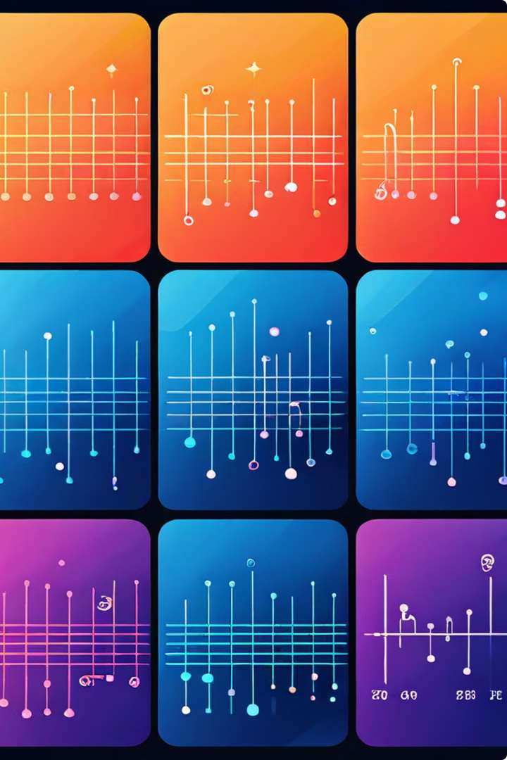



Data Augmentation
Data augmentation is not needed in this case because the dataset is large enough for training.
Sufficient Data
The dataset is already large enough for training.
No Need for Augmentation
Data augmentation is not necessary.

Slide 10
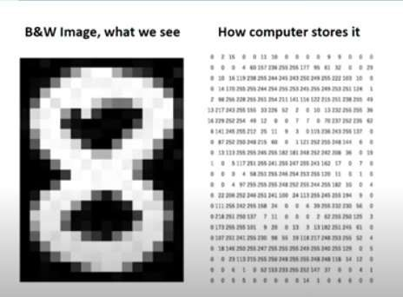
Feature Extraction:
The process of transforming raw data into a set of features that can be used for machine learning.
Essential for improving model performance and reducing computational cost.

Slide 11
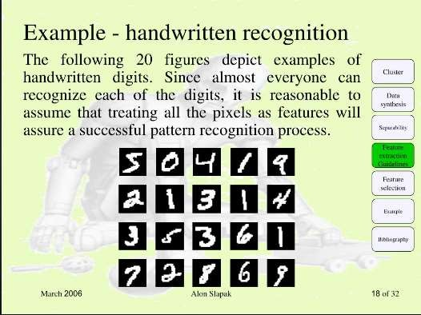
Feature Extraction
Techniques for F lattening, HOG F eatures and PCA

Slide 12

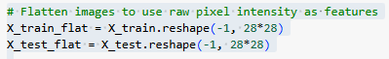
Flattening Images
Why Flatten Images?
To convert the 2D array of pixel values into a 1D array.
Simplifies the data structure for models like
logistic regression or fully connected neural networks.

Slide 13
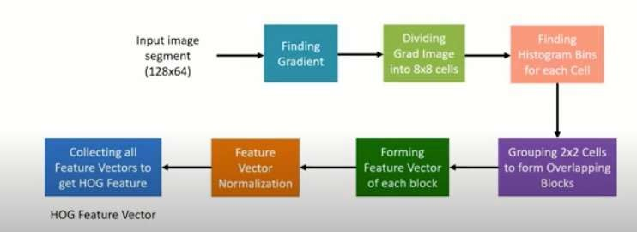
Histogram of Oriented Gradients (HOG)
A feature descriptor used in computer vision and image processing for object detection.
Why Use HOG?
Useful for tasks like face detection, object recognition.
Effective for capturing edge or gradient structure in images.

Slide 14
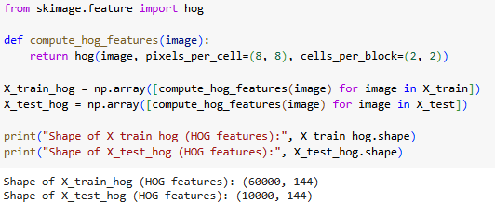
The HOG feature extraction process converts images into a set of HOG features.
Each image is represented by a 1D array of HOG features, capturing the gradient structure and appearance of objects within the image.

Slide 15
Principal Component Analysis
A dimensionality reduction technique that transforms data into a lower-dimensional space.
Retains the most important features while reducing the noise.
Why Use PCA?
Reduces the number of features, making data easier
to handle and visualize.
Helps to avoid the curse of dimensionality.

Slide 16

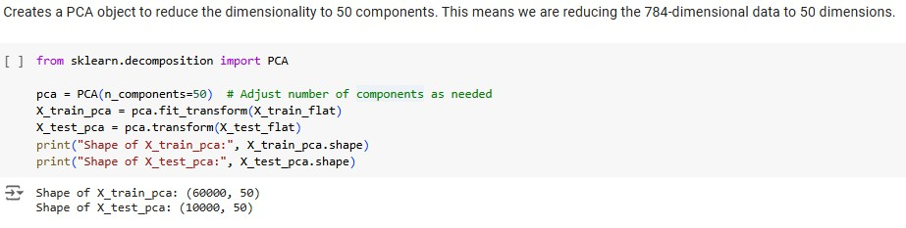
Principal Component Analysis (PCA) is used to reduce the dimensionality of the data.
Each image, originally represented by 784 pixels, is reduced to a 50-dimensional feature vector.

Slide 17
Comparis on of Techniques
Flattening: Simplest, retains all pixel information.
HOG: Focuses on gradient orientations, effective for object recognition.
PCA: Reduces dimensionality, helps in noise reduction and faster computation.

Slide 18


Support Vector Machines
Now we will explores the use of Support Vector Machines (SVMs) in machine learning. We will dive into the core concepts, implementation details, and model evaluation techniques.

Slide 19


Training the SVC Model
We train the `SVC` model using the training data. We set the kernel to `'linear'` and fit the model to the training features (`X_train_flat`) and corresponding labels (`y_train`).
Code
Description
model = SVC(kernel='linear')
Creating an instance of the `SVC` class with a linear kernel.
model.fit(X_train_flat, y_train)
Training the model on the training data.

Slide 20



Evaluating the Model Performance
Model evaluation is essential to assess the performance of the trained SVM. We use metrics like accuracy score and classification report to understand how well the model performs on unseen data.
Accuracy Score
Measures the proportion of correctly predicted instances among all instances.
Classification Report
Provides a detailed breakdown of precision, recall, F1-score, and support for each class.

Slide 21

Digit Recognition
using Convolutional Neural Networks (CNN)

Slide 22

Introduction
1
Objective
To build a Convolutional Neural Network (CNN) to recognize handwritten digits using the MNIST dataset.
2
Tools Used
TensorFlow, Keras, Matplotlib, OpenCV, Numpy.

Slide 23

S tep 1 : Import Neces sary Libraries
TensorFlow
import tensorflow as tf
Keras
from tensorflow.keras .datasets import mnis t from tensorflow.keras .models import Sequential from tensorflow.keras .layers import Conv2D, MaxP ooling2D, F latten, Dense, Dropout from tensorflow.keras .utils import to_categorical
Matplotlib, OpenC V, Numpy
import matplotlib.py plot as plt import numpy as np import cv2

Slide 24

Step 2: Load and Preprocess MNIST Data
1
Load Data
Split into training and test sets.
2
Normalize Pixel Values
Scale pixel values to be between 0 and 1 .
3
Reshape Data
Add a channel dimension.
4
One-Hot Encode Labels
Convert labels to categorical format.

Slide 25
S tep 3: Define the CNN Model
Architecture
Consists of Conv2D, MaxP ooling2D, Flatten, Dense, and Dropout layers .
Code
model = S equential([ Conv2D(32, kernel_size=(3, 3), activation='relu', input_shape=(28, 28, 1)),
MaxPooling2D(pool_size=(2, 2)), Conv2D(64, kernel_size=(3, 3), activation='relu'),
MaxP ooling2D(pool_size=(2, 2)), Flatten(), Dense(128,
activation='relu'), Dropout(0.5), Dense(10, activation='softmax') ])

Slide 26




S tep 4: Compile the Model
Optimizer
Adam.
Loss Function
Categorical Crossentropy.
Metrics
Accuracy.

Slide 27

Step 5: Train the Model
Training Parameters | Value
Validation split | 20%
Epochs | 10
Batch size | 128

Slide 28


Step 6: Evaluate the Model
Evaluate on Test Data
Compute accuracy on the test set.
Print Accuracy
print(f'Test accuracy: {test_accuracy:.4f}')

Slide 29

Step 7: Visualize Training History
Plot Accuracy and Loss
For both training and validation sets.

Slide 30

S tep 8: S ave and Load the Model
1
S ave Model
To an .h5 file.
2
Load Model
From the .h5 file for future predictions.

Slide 31
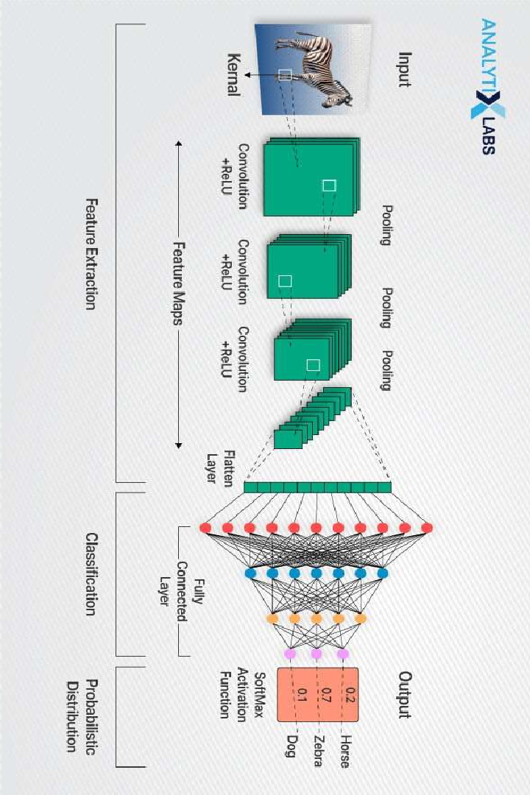
CNN
optimized Classification
CNNs optimize the classification process by efficiently categorizing images based on learned patterns.
Complex Pattern Recognition
CNNs are adept at recognizing intricate patterns within images, improving recognition capabilities.
Efficient Image Analysis
CNNs are proficient in analyzingvisual imagery, making them ideal for image classification tasks.
Feature Extraction
CNNs excel at extracting essential features from images to enhance accuracy in classification.

Slide 32
Comparison: CNN vs. S VM for Digit R ecognition
CNN achieves higher accuracy rates compared to SVM for digit recognition tasks.
CNN generally requires more training time due to its deeper architecture and extensive learning process.
01
02
SVM may lag behind CNN in accuracy due to its linear nature and limited ability to handle complex patterns.
SVM typically trains faster than CNN as it deals with a smaller feature set and simpler computations.

Slide 33

Development Process
1
Flask Environment
2
Handling SVM and CNN Models
3₃
Handling Image Uploads and Predictions

Slide 34
Thanks
x

